Slide 1
FILESYSTEM IN USERSPACE (FUSE)
BLG413E – System Programming, Practice Session 4

Slide 2
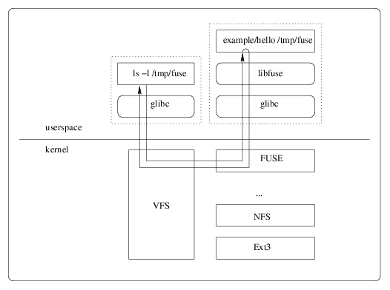
Filesystem in userspace (FUSE)
Simple installation (no need to patch or recompile the kernel)
Secure implementation
Usable by non privileged users (via userspace-kernel interface)

Slide 3
FUSE Development
Install: libfuse-dev
To use FUSE library functions: #include <fuse.h>
Main function of FUSE: fuse_main(argc, argv, op, user_data)

Slide 4
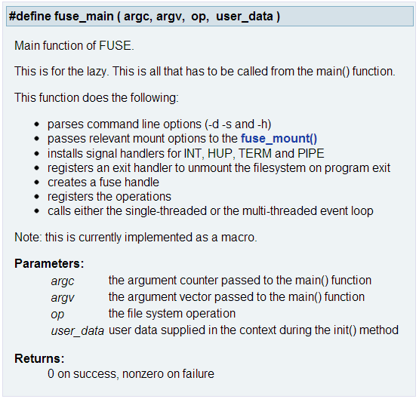

Slide 5
Hello world in FUSE
See hello.c
Compiling: gcc hello.c -o hello -D_FILE_OFFSET_BITS=64 -lfuse
-lfuse: link FUSE
-D_FILE_OFFSET_BITS=64: force all file access calls to use the 64 bit variants. Not setting -D_FILE_OFFSET_BITS=64 would result in different sized types in several structures and function calls. Moreover, FUSE requires to set -D_FILE_OFFSET_BITS=64.

Slide 6
Hello world in FUSE
Mounting: ./hello <mount_dir>
grep hello /etc/mtab
cat <mount_dir>/hello
Unmounting: fusermount −u <mount_dir>
grep hello /etc/mtab
Running in debug mode: ./hello -d <mount_dir>
lists all currently mounted file systems along with their initialization options

Slide 7
Read Only File System (ROFS)
See rofs.c
Compiling: gcc rofs.c -o rofs -Wall -ansi -W -std=c99 -g -ggdb -D_GNU_SOURCE -D_FILE_OFFSET_BITS=64 -lfuse
-Wall: enable all basic compiler's warning messages
-ansi: enforce ANSI C standards
-W: enable some extra warning flags that are not enabled by –Wall
-std=c99: use c99 standards
-g: produce debugging information in the operating system's native format
-ggdb: produce debugging information for use by GDB
-D_GNU_SOURCE: use GNU standards

Slide 8
Read Only File System (ROFS)
Mounting: ./rofs test1 test2
(It is better to use ROFS in debug mode as it gives problems when it is mounted normally)
ls -l
grep rofs /etc/mtab
Unmounting: fusermount −u test2
ls -l
grep rofs /etc/mtab
Running in debug mode: ./rofs –d test1 test2

Slide 9
Read Only File System (ROFS)
Try to create a file/directory under test1 and see what happens under test2
Try to create a file/directory under test2
Try to modify a file under test2

